Slide 1
Sex-linkage
For lab 6
Introduction to Drosophila

Slide 2
Moving into Chapter 4
We will begin to think about extensions to what Mendel saw in his pea plant studies.
Starting with section 4.11 to help us with our Drosophila lab. (starting p. 87)
Section 4.11 has us consider, that unlike many plants, most sexually reproducing animals show clear-cut sexes---male and female, but not both in the same organism.
Sex (male or female) determination is of course, determined by specific genes.

Slide 3
Chapter 7 covers sex determination and we will read some of chapter 7
For some organisms we refer to the chromosomes that carry the genes for sex determination (during development) as sex chromosomes.
All other chromosomes having no genes for sex determination are called autosomes.
Humans have 22 autosomes, and 2 sex chromosomes, X and Y.
Males have 1 X and 1Y
Females have 2 X chromosomes

Slide 4
In humans, Y chromosome determines maleness.
How do we know?...
A number of syndromes result from meiotic non-disjunction giving various numbers of X and Y in offspring.
(45, X) ---Turner syndrome (develops as female)
(47, XXY)—Kleinfelter syndrome (develops male)
Presence of Y, defines maleness even if the person has XX.

Slide 5
Drosophila also has X and Y chromosomes.
XX—female
XY ---Male
(slightly different way of determining sex)

Slide 6
Back to humans…let’s compare X and Y
X—large and important!! Encodes 1,098 genes
Y—smaller (less important?...) Encodes 78 genes.

Slide 7
Electron micrograph
Y-chromosome
X-chromosome

Slide 8
Scientifically verified
Some “suspected” Y-linked genes ☺

Slide 9
Y-chromosome (The real Y)
2 main regions ---
MSY—male specific region
PAR—pseudoautosomal region (small region with homology (sequence similarity) to X
(SEE chapter 7! Section 7.3-7.4)

Slide 10
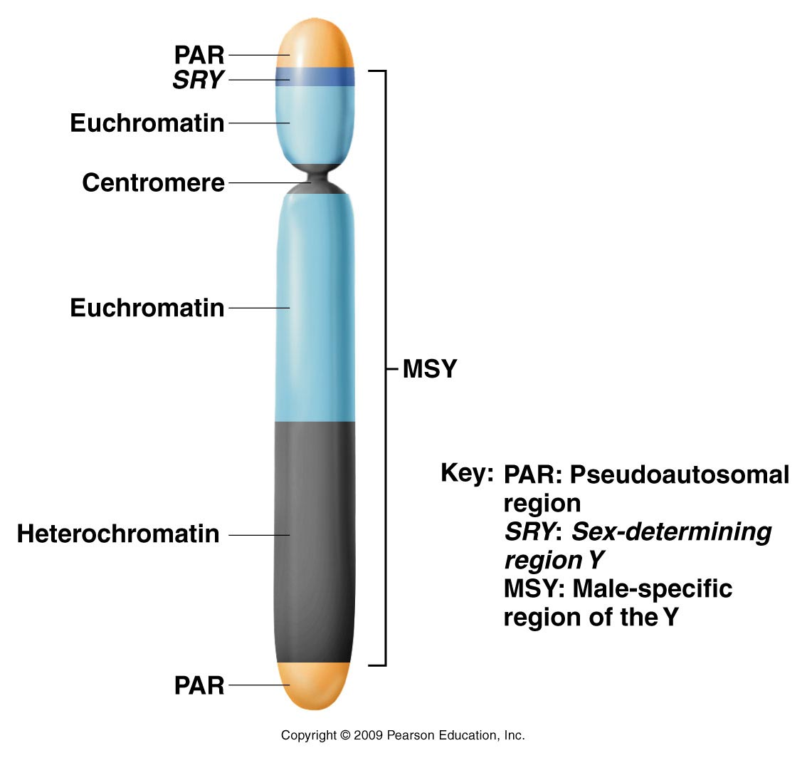
Thinker question---Why would the Y chromosome have to have some sequence similarity (homology) to X?
Figure 7.9
Notes:
Figure 7-9 The various regions of the human Y chromosome.

Slide 11
PAR facilitates the necessary alignment of X and Y during meiosis
Each gamete receives X or Y from male in sperm, one X from female in eggs.
Fertilization of egg (carrying X) by sperm (carrying X or Y) will create XX female zygote, or XY male zygote.
Male determines the sex of the child

Slide 12
X and Y are not true homologs (Although they do pair in meiosis)
Must consider the difference in males and females in terms of X and Y-linked genes

Slide 13
Females----homogametic sex.
2 copies of every gene located on X chromosome. (similar to autosomes)
No genes from Y chromosome
X X

Slide 14
Males----heterogametic sex.
One copy of genes located on X, one copy of genes located on Y---can be nethier homozygous or heterozygous for X or Y linked genes----instead HEMIZYGOUS.
X Y

Slide 15
Practice the pedigree for sex determination
Just show males and females and how they can inherit their sex chromosomes.
Every female gets one of her mother’s X chromosomes and her father’s only X chromosome.
Every male gets one his mother’s X chromosomes and his fathers Y chromosome.

Slide 16
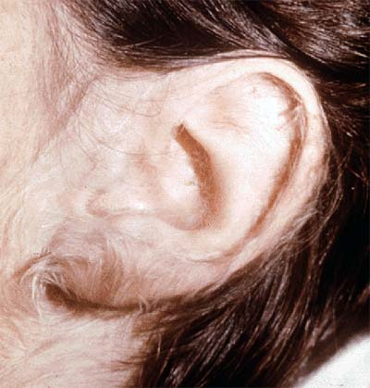
What are sex-linked traits? (traits controlled by genes located on sex chromosomes—X or Y)
Start with a rare Y-linked trait. (So few genes on Y that these traits are rarely noted.)
“hairy ear” trait has been mapped to a gene on the Y chromosome.
On board

Slide 17
For example---hairy ears

Slide 18
Be careful interpreting pedigrees. Is it true that a Y-linked trait pedigree will show every male shaded? affected?
Are females ever affected?
Are Y-linked traits truly dominant or recessive?
Can they skip a generation and reappear?

Slide 19
X-linked traits
Much more common than Y-linked traits (many more genes on X)
First recognized in Drosophila by Thomas Morgan
Noted that the white eye trait was inherited in a sex-linked way---concluded that the white mutation was in a gene on the X-chromosome

Slide 20
To study, you must track both the trait and the sex of the organism showing the trait.
Let’s review Drosophila eye color. White eyes is a recessive trait. The dominant color is red.
The inheritance of white eyes looks different from the autosomal recessive traits we’ve seen so far---depending on how the cross is setup.

Slide 21
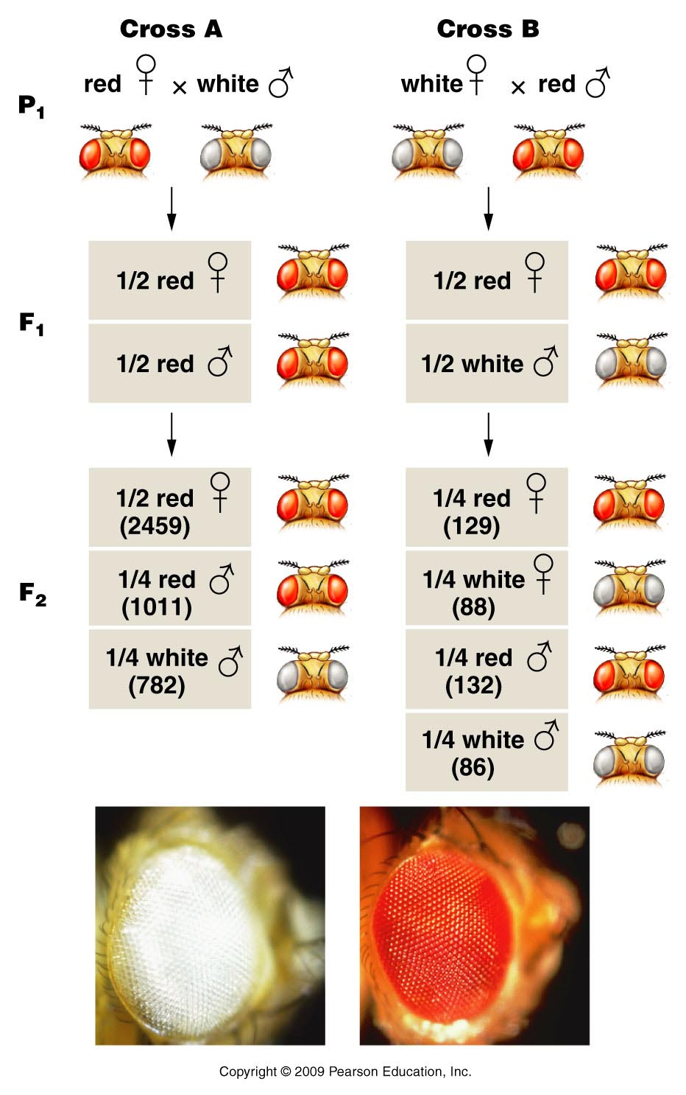
Unlike Mendel, Morgan noted differences in reciprocal crosses
F1 shows both parental traits
3:1 but only males have white eyes
F2 shows 1:1 ratio
Figure 4.12
Notes:
Figure 4-12 The F¹ and F² results of T. H. Morgan’s reciprocal crosses involving the X-linked white mutation in Drosophila melanogaster. The actual data are shown in parentheses. The photographs show white eye and the brick-red wild-type eye color.

Slide 22
Morgan proposed, that the gene controlling eye color was sex-linked. The fact that only males had white eyes in the F1 of cross A suggested X-linked.
He tried the following scheme to explain the unexpected pattern of inheritance.

Slide 23
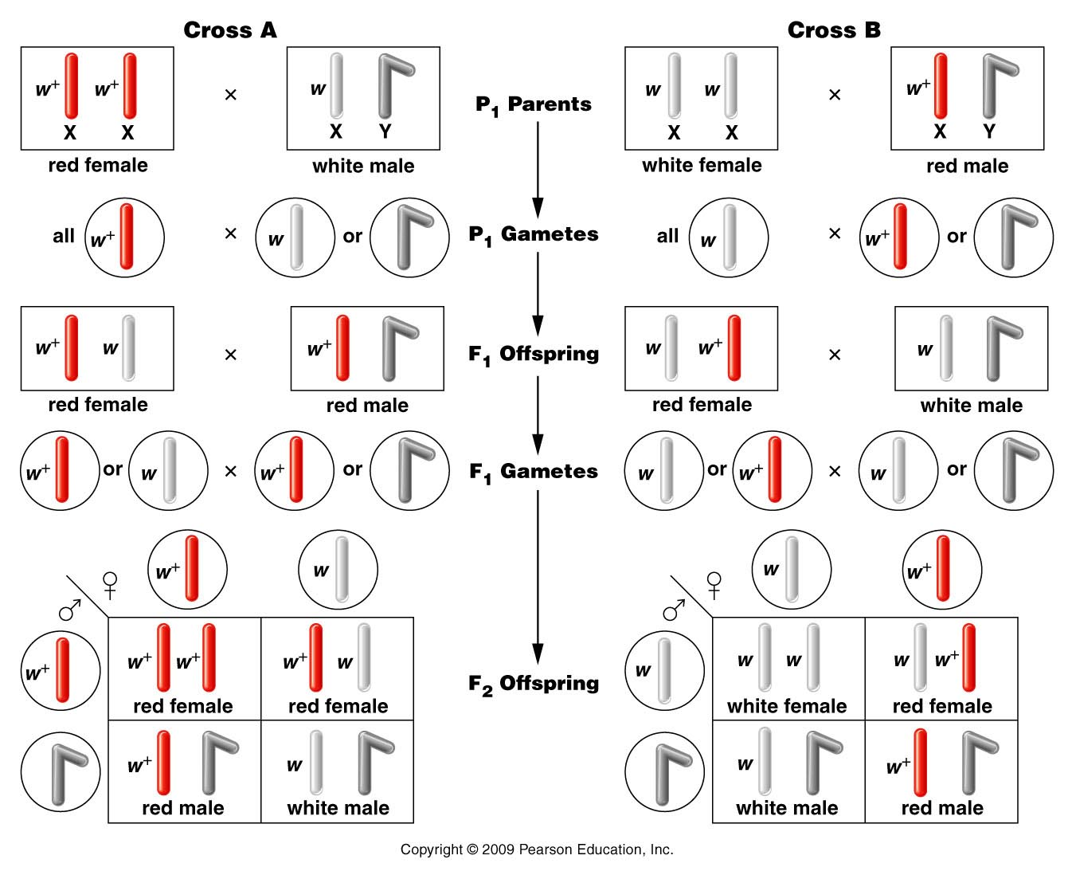
Figure 4.13
Notes:
Figure 4-13 The chromosomal explanation of the results of the X-linked crosses shown in Figure 4–11.

Slide 24
The hypothesis that the w (white) allele was located on the X chromosome, is consistent with patterns of inheritance in both reciprocal crosses.
All 3 mutations you noticed today are in genes located on the X-chromosome. They are X-linked recessive traits, controlled by X-linked genes.
Let’s follow up by sketching our own Mendelian/”Morganian” crosses to predict inheritance of the traits through 2 generations.

